Slide 1

Recursion
Bagian 1

Slide 2
Pembahasan
Konsep Rekursif
Cara menuliskan
Bagaimana metode recursive diatasi dalam sistem
Latihan

Slide 3
Quote
To understand recursion, you have to understand recursion first

Slide 4
Apa itu rekursi?
Sub program dapat memanggil sub program lainnya
Apabila sub program memanggil dirinya sendiri, inilah yang disebut dengan rekursif

Slide 5
Penulisan rekursi pada prosedur atau fungsi
Prosedur rekursif:
Procedure proc();
Begin
proc();
End;
Fungsi rekursif:
Function func();
Begin
func();
End;

Slide 6
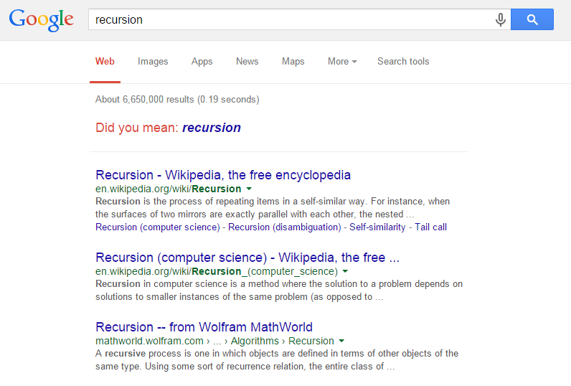
Hasil pencarian di google

Slide 7
Pemanggilan fungsi rekursif
Pemanggilan secara langsung (direct call)
Pemanggilan tak langsung (indirect call)

Slide 8
Direct Call
procedure proc;
begin
:
proc ();
:
end;
module

Slide 9
Indirect Call
m¹
m²

Slide 10
Indirect Call
m¹
m²
m³
…
m^{n}

Slide 11
Indirect Call (2)
procedure proc1;
begin
:
proc2;
end;
procedure proc2;
begin
:
proc3;
end;
procedure proc3;
begin
:
proc1;
end;

Slide 12
Permasalahan Indirect Recursion
Contoh scenario:
Procedure mana yang harus didefinisikan lebih dulu?
proc1
proc2
proc2
proc1

Slide 13
Procedure Proc1 Pertama?
procedure proc1;
begin
:
proc2;
:
end;
procedure proc2;
begin
:
proc1;
:
end;
What is proc2?

Slide 14
Procedure Proc2 Pertama?
procedure proc2;
begin
:
proc1;
:
end;
procedure proc1;
begin
:
proc2;
:
end;
What is proc1?

Slide 15
Solusi: Gunakan Dummy Definition
A "placeholder" for the compiler (definition comes later)
Example problem
procedure proc1;
begin
:
proc2;
:
end;
procedure proc2;
begin
:
proc1;
:
end;

Slide 16
Solusi: Gunakan Dummy Definition
A "placeholder" for the compiler (definition comes later)
Example problem
procedure proc2; FORWARD;
procedure proc1;
begin
:
proc2;
:
end;
procedure proc2;
begin
:
proc1;
:
end;

Slide 17
Konsep Faktorial
n! = n*(n-1)!
= n*(n-1)*(n-2)!
...
= n*(n-1)*(n-2)*(n-3)... 1
Contoh:
5! = 5 . 4!
Rekursif

Slide 18
Konsep Faktorial
n! = n*(n-1)!
= n*(n-1)*(n-2)!
...
= n*(n-1)*(n-2)*(n-3)... 1
Contoh:
5! = 5 . 4! = 5 . 4 . 3!
Rekursif

Slide 19
Konsep Faktorial
n! = n*(n-1)!
= n*(n-1)*(n-2)!
...
= n*(n-1)*(n-2)*(n-3)... 1
Contoh:
5! = 5 . 4! = 5 . 4 . 3! = 5 . 4 . 3 . 2!
Rekursif

Slide 20
Konsep Faktorial
n! = n*(n-1)!
= n*(n-1)*(n-2)!
...
= n*(n-1)*(n-2)*(n-3)... 1
Contoh:
5! = 5 . 4! = 5 . 4 . 3! = 5 . 4 . 3 . 2!
= 5 . 4 . 3 . 2 . 1
Rekursif

Slide 21
Contoh program faktorial
program factorialProgram (input, output);
function factorial (num :integer):integer;
begin
if (num = 1) then
factorial := 1
else
factorial := num*factorial(num - 1);
end;
begin
var number, nFactorial :integer;
write('Enter the number for factorial :');
readln(number);
nFactorial := factorial(number);
writeln(number, '! = ', nFactorial);
end.

Slide 22
User Types in 3
nFactorial = factorial(3)
6
factorial (3)
if (3 = 1) then
factorial := 1
else
factorial := 3 * factorial(3 – 1);
false
2
factorial (2)
if (2 = 1) then
factorial := 1
else
factorial := 2 * factorial(2 – 1);
false
1
factorial (1)
if (1 = 1) then
factorial := 1
else
factorial := 1 * factorial(1 – 1);
true

Slide 23
Contoh Program penjumlahan
program sumSeries (input, output);
function sum (no : integer): integer;
begin
if (no = 1) then
sum := 1
else
sum:= (no + sum (no - 1));
end;
begin
var lastNumber, total : integer;
write('Enter the last number in the series :');
readln(lastNumber);
total := sum(lastNumber);
writeln('Sum of the series from 1 to
`lastNumber, ' is, ‘ total);
end.
sumSeries
total = sum(3)
6
sum (3)
if (3 = 1) then
sum := 1
F
else
sum := (3 +sum (3 – 1));
3
sum (2)
if (2 = 1) then
sum := 1
F
else
sum := (2 +sum (2 – 1));
1
sum (1)
if (1 = 1) then
sum := 1
T

Slide 24
Contoh program fibonacci
program fibo_using_rekursif;
var
x,i: integer;
function fib(n:integer):integer;
begin
if(n=1) then
fib:=1
else
if (n=2) then
fib:=1
else
fib:= fib(n-1)+fib(n-2);
end;
begin
writeln('deret fibonacci');
write('input value : ');
readln(x);
writeln;
for i := 1 to x do
write(fib(i),' ');
readln;
end.

Slide 25
Latihan Pangkat Bilangan
Buat program untuk memangkatkan suatu bilangan berdasarkan input dari user. Program menggunakan fungsi atau prosedur yang bersifat rekursif.
Outpur program: Masukkan bilangan: 5
Masukkan pangkat bilangan: 3
5 ^ 3 = 125

Slide 26
Latihan Segitiga Pascal
Buat segitiga pascal dengan menggunakan fungsi atau prosedur rekursif. Dimana, tinggi segitiga pascal ditentukan oleh user.
1
1 1
1 2 1
1 3 3 1
1 4 6 4 1
1 5 10 10 5 1
1 6 15 20 15 6 1

Slide 27
Next week
Recursion bagian 2:
Perbedaan antara recursive dan iterative serta kapan menggunakannya
Penggunaan recursive
Teknik pemecahan masalah menggunakan recursive

Slide 28
Terimakasih

